Slide 1
ACADEMIC SESSION 2024
DR.MANOJIT SARKAR
MBBS,MS(Surgery,NRSMCH),FMAS(AIIMS),CMAS(New Delhi),CC in Surgery(Royal College of Surgeons),Dip.Urology(UK),PG.Dip HPB(Hepato-pancreato-biliary Surgery),Fellow in Gastroenterology,CC In Gastroenterology & Hepatology,CC in Colo-Proctology,CC in Hernia,CC in Breast & Thyroid Surgery & Onco Surgery
ASSOCIATE FELLOW OF AMERICAN COLLEGE OF SURGEONS
Special interest in Upper GI,Oncosurgery & Uro Surgery
Consultant Laparoscopic GI,Colorectal & ONCO & General Surgeon & Physician
ATTACHED TO BURDWAN MEDICAL COLLEGE & HOSPITAL
FORMERLY NRS MEDICAL COLLEGE & HOSPITAL

Slide 2
WHY THIS SESSION????

Slide 3
JUDICIAL USE OF ANTIBIOTICS

Slide 4
UNNESSESARY USE OF STEROIDS

Slide 5
SOME VIGNETTE OF SPECIAL OPERATIONS

Slide 6
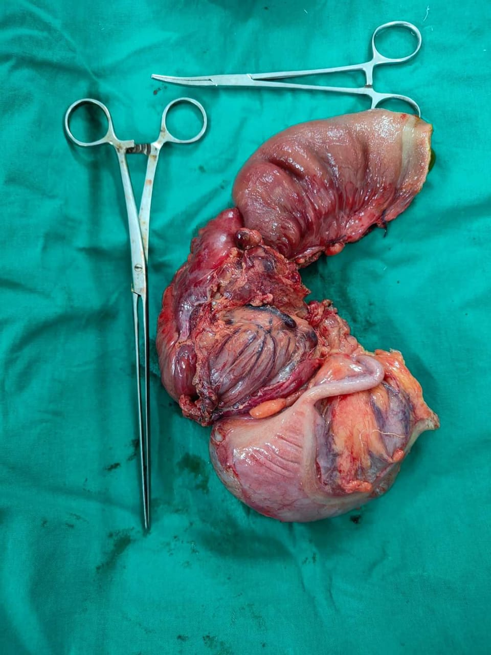
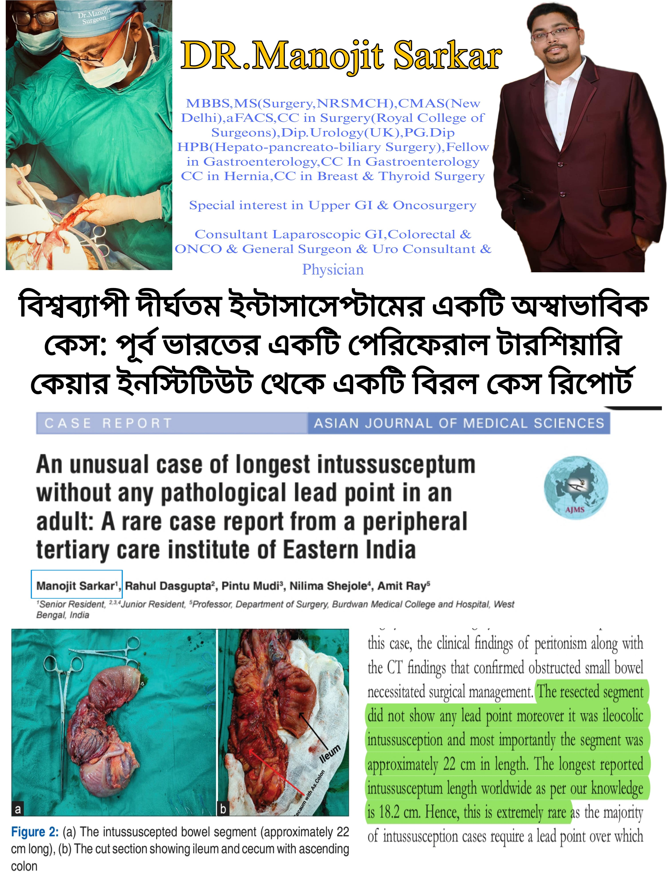

Slide 7
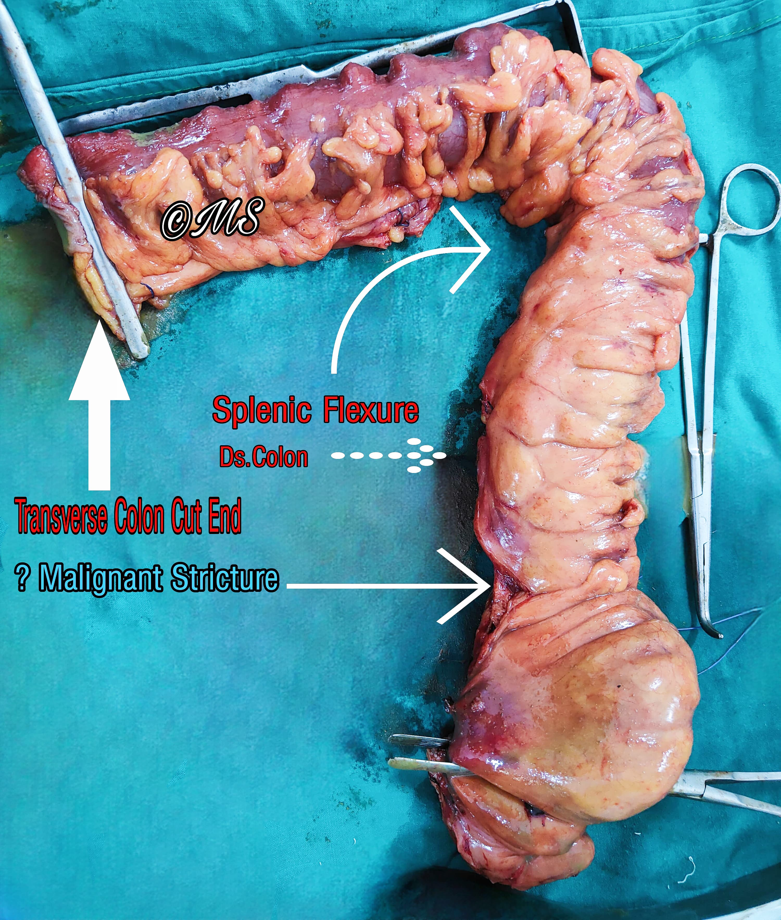

Slide 8
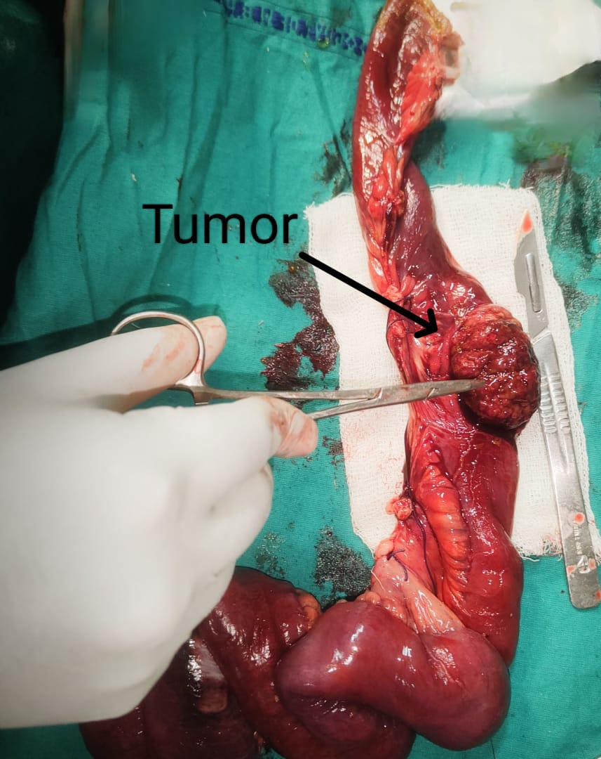

Slide 9
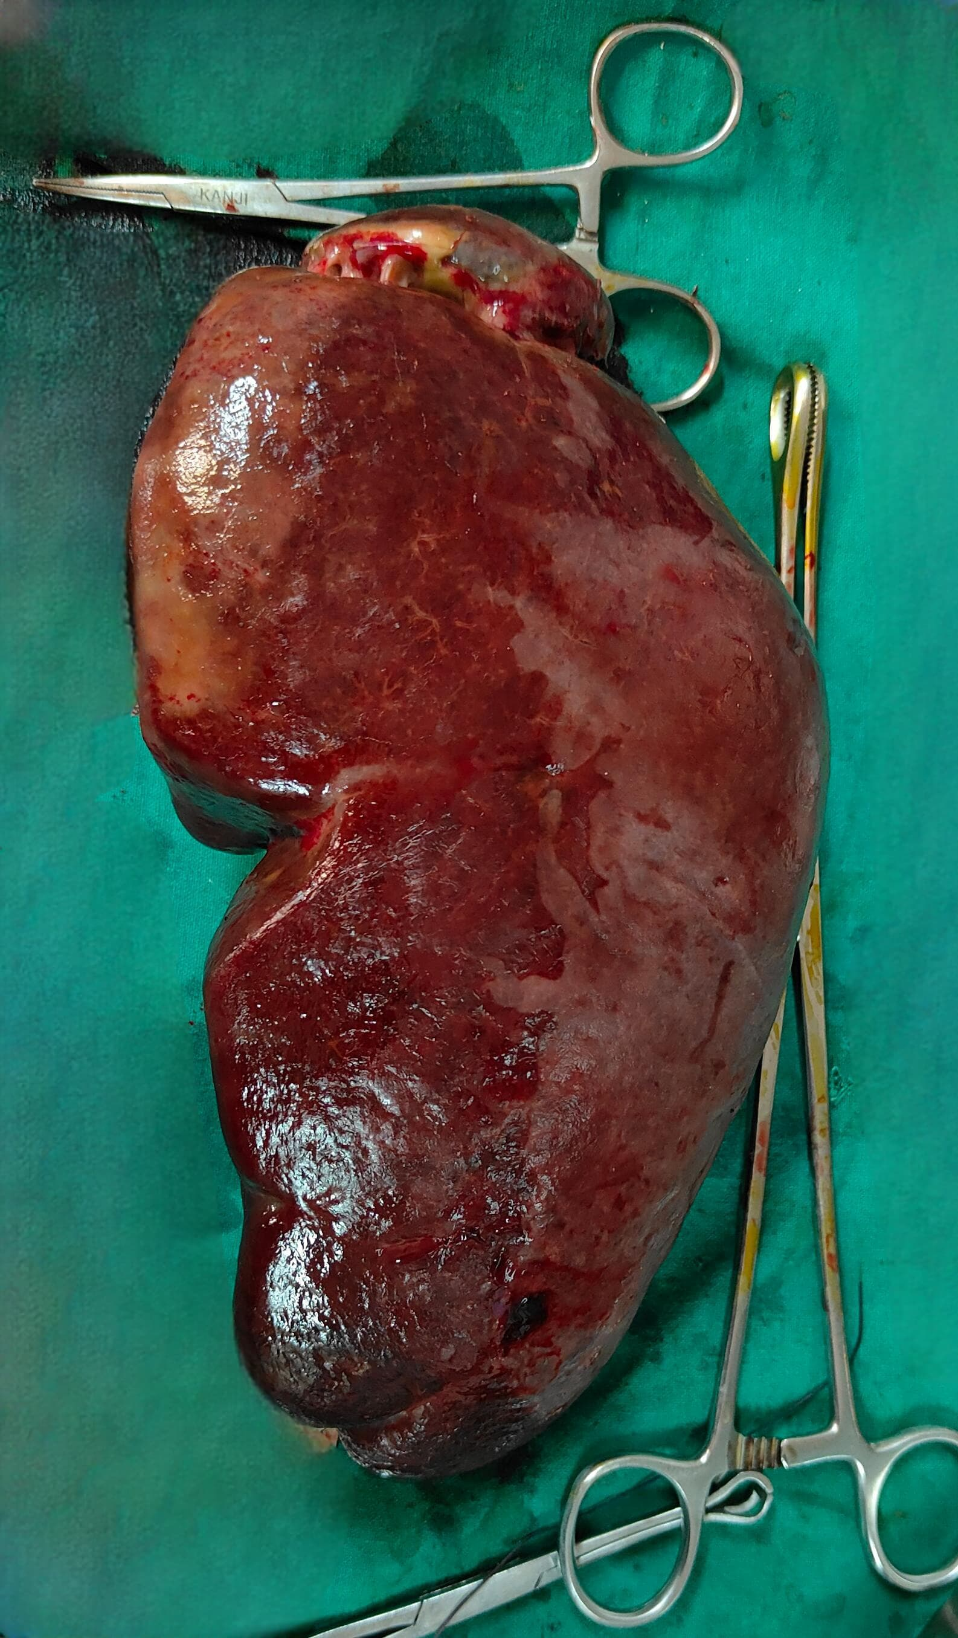
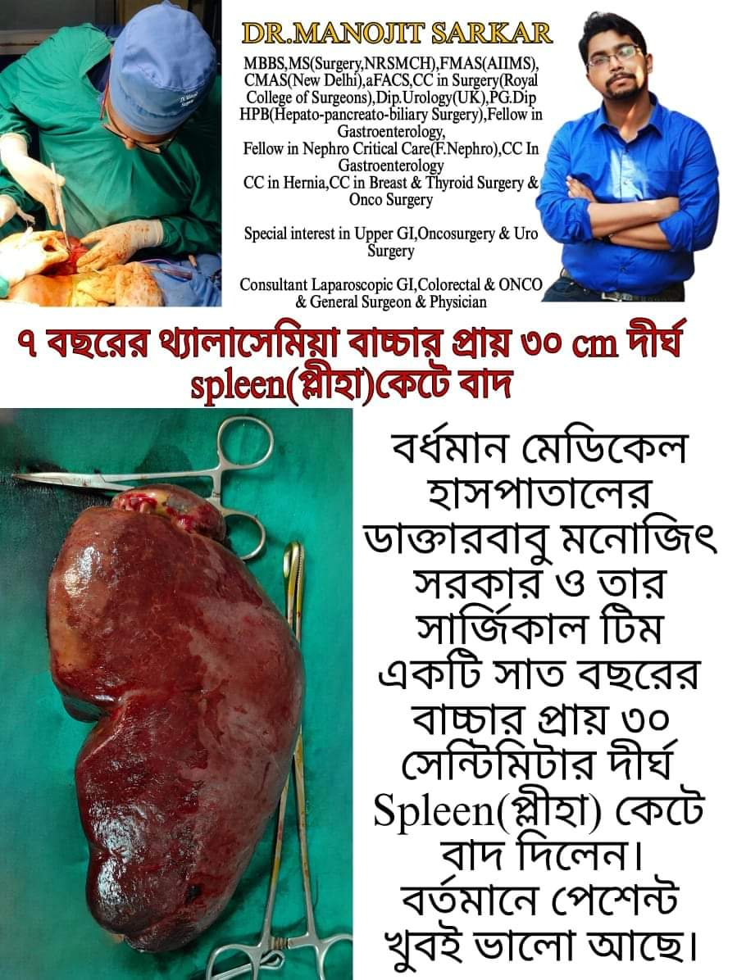

Slide 10
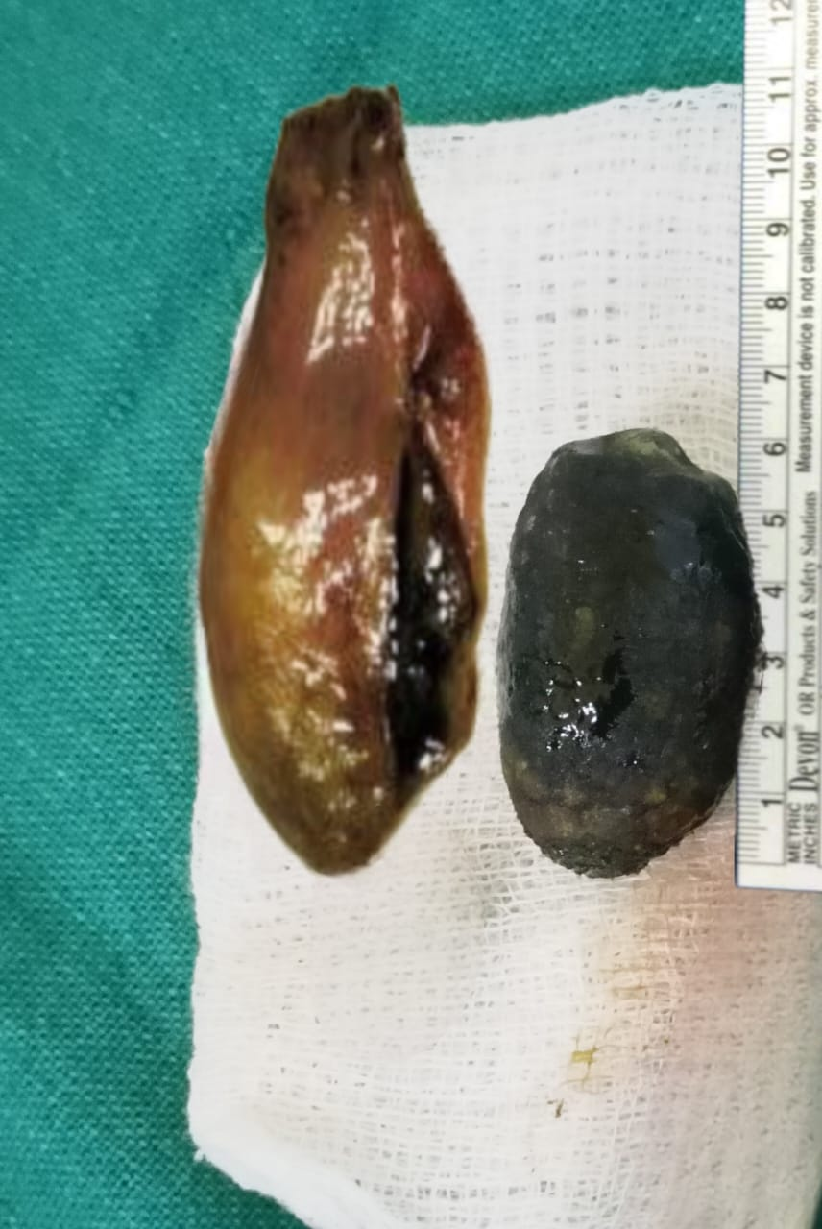

Slide 11
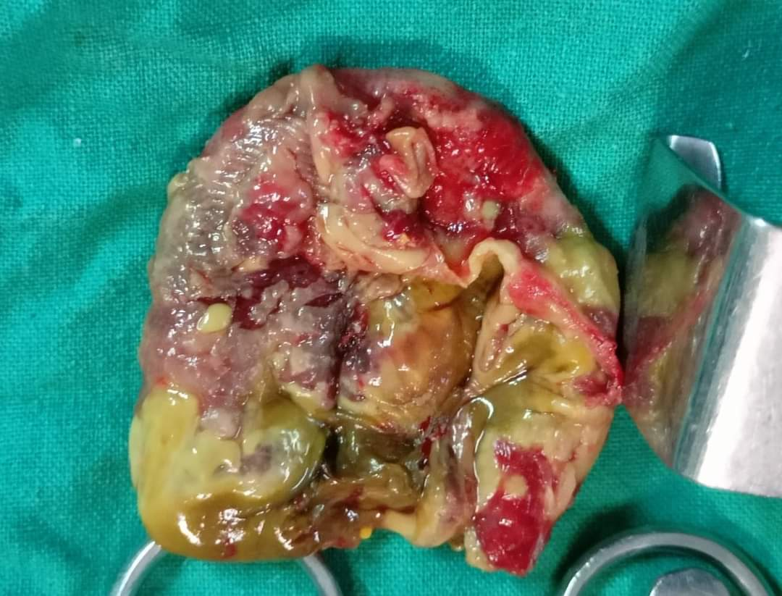

Slide 12
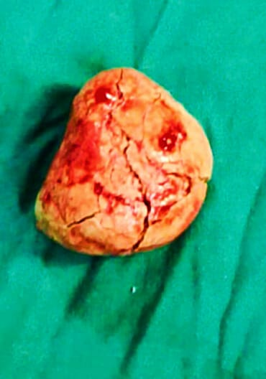

Slide 13
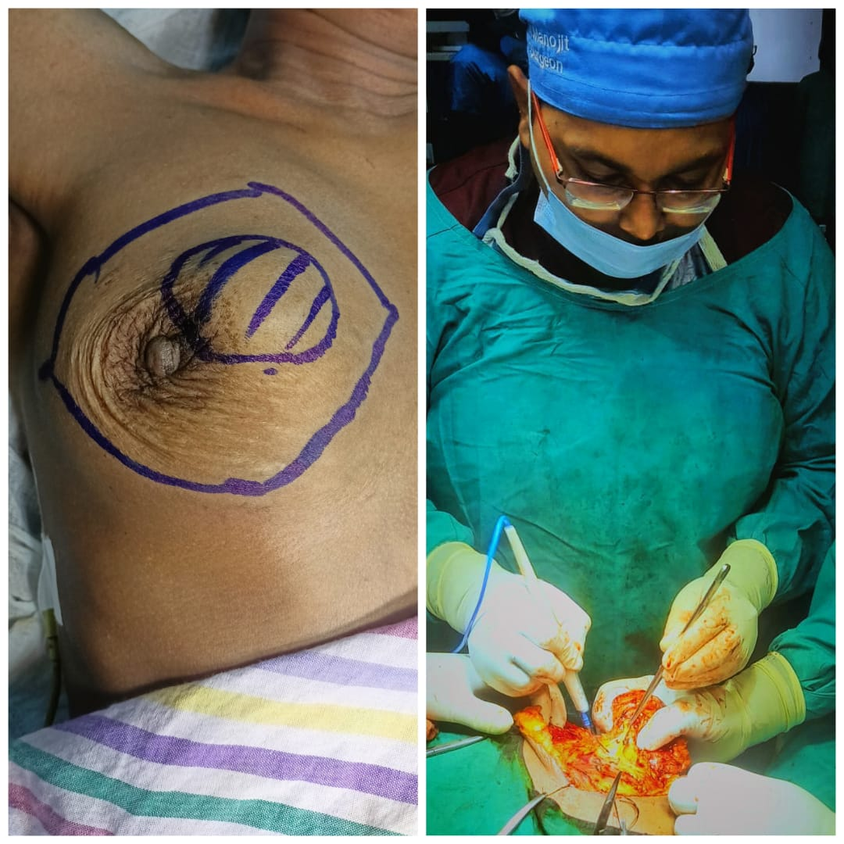

Slide 14
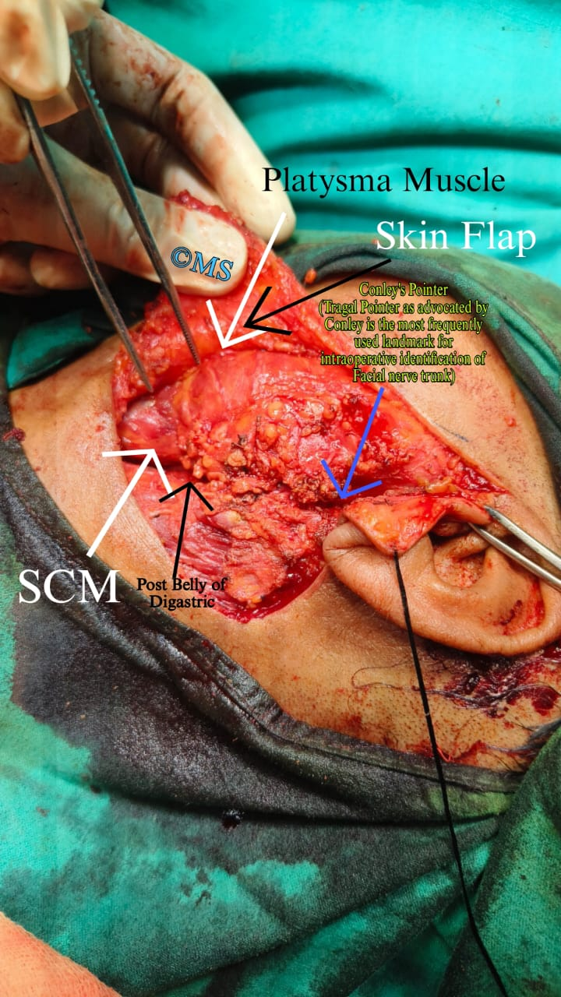

Slide 15


Slide 16
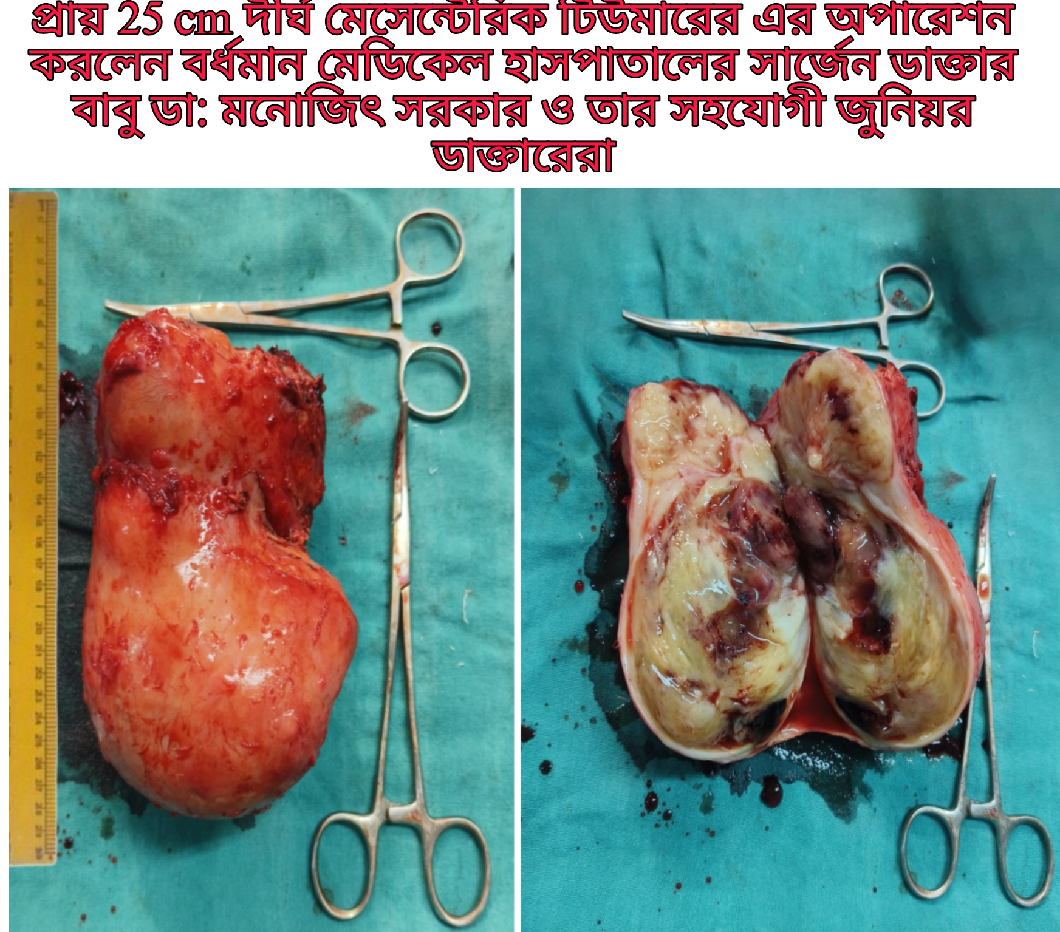

Slide 17
ANY QUESTIONS???

Slide 18
HOPE YOU HAVE ENJOYED THIS SESSION

Slide 19
THANK YOU

